Slide 1
Coffee Lovers
Of Toronto

Slide 2
According to the Coffee Association of Canada, in a 2017 study, 71% of participants responded that they had consumed coffee the previous day. Obviously, we are a population who loves coffee. This offers a huge market for entrepreneurs who want to satisfy this desire for coffee.

Slide 3
In order to determine which neighborhood might offer the best opportunity for opening a coffee house in Toronto, we will look at the current coffee distribution per neighborhood and also consider the population of each neighborhood.

Slide 4
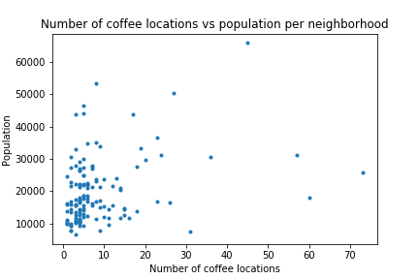
Based on data from this report, there are 1177 coffee locations in Toronto spread over 140 neighborhoods.

Slide 5
Neighborhoods with the highest number of coffee locations
Bay Street Corridor
Kensington-Chinatown
Church-Yonge Corridor
Waterfront Communities-The Island
Annex

Slide 6
Neighborhoods with the lowest number of coffee locations
Steeles
Lansing-Westgate
Cliffcrest
Oakridge
Princess-Rosethorn

Slide 7
When looking at this data, we might assume that the neighbourhoods with the highest number of coffee houses are likely already saturated, and therefore, would not be the ideal place to open a new location.
A better approach might be to determine the neighborhoods which have the highest population to coffee house ratio. These neighborhoods are not yet saturated and would likely have the most potential in customer base for opening a new location.

Slide 8
Neighborhoods with highest population to coffee house ratio
Steeles
Lansing-Westgate
Cliffcrest
Glenfield-Jane Heights
Malvern

Slide 9
Further investigation is warranted to determine is there are reasons why these neighborhoods have fewer coffee locations and thus would not be ideal locations for new coffee businesses.
Also, neighborhoods with the highest number of coffee locations could indicate a population where coffee is particularly popular. A brave entrepreneur might want to try to squeeze into one of these neighborhoods.
This report provides a solid starting place to provide information about the current coffee house distribution across neighborhoods in Toronto.

